Slide 1
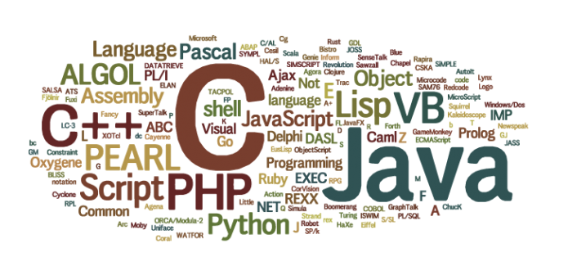
Software Development & Best Practices
This Photo by Unknown Author is licensed under CC BY
Lecture 3 – Programming and PHP

Slide 2
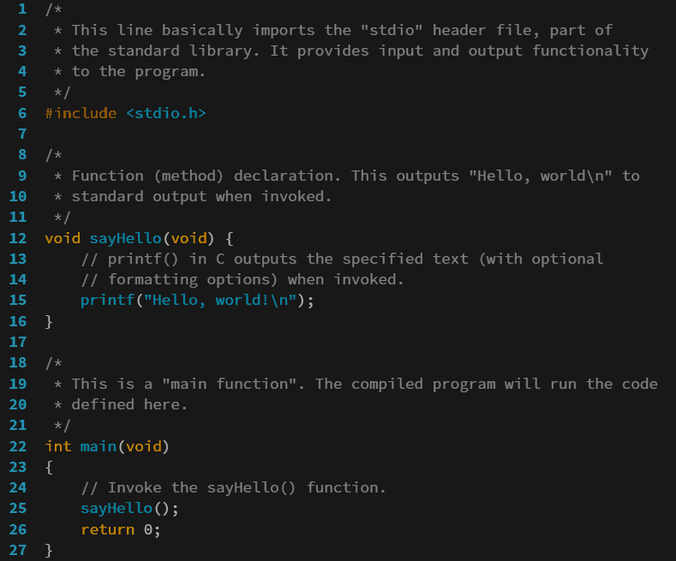
Programming
Programming is simply a word we use for: “Getting a computer to do what we want it to do”
A program is a list of instructions which alters the computer’s behavior in a predictable way.
The tools we use to tell computers what to do are known as “programming languages”.
These tools are, for the most part collection of “statements”
Any group of statements that are put together are called a “program”.
This Photo by Unknown Author is licensed under CC BY-SA

Slide 3
Programming
This Photo by Unknown Author is licensed under CC BY
A programming language consists of statements. These statements generally fall into one six types.
Assignment: Stores data in a variable.
Expressions: Variables and other elements are combined to create a result
Iteration: Statements which cause the computer to execute specific statements repeatedly.
Conditionals: Tells the computer to execute specific statements only under a specific set of conditions.
Execution: Tells the computer to do something like print to the screen or write to a file.
Inclusion: Tells a program to pull in statements from another file to help it perform some function.

Slide 4
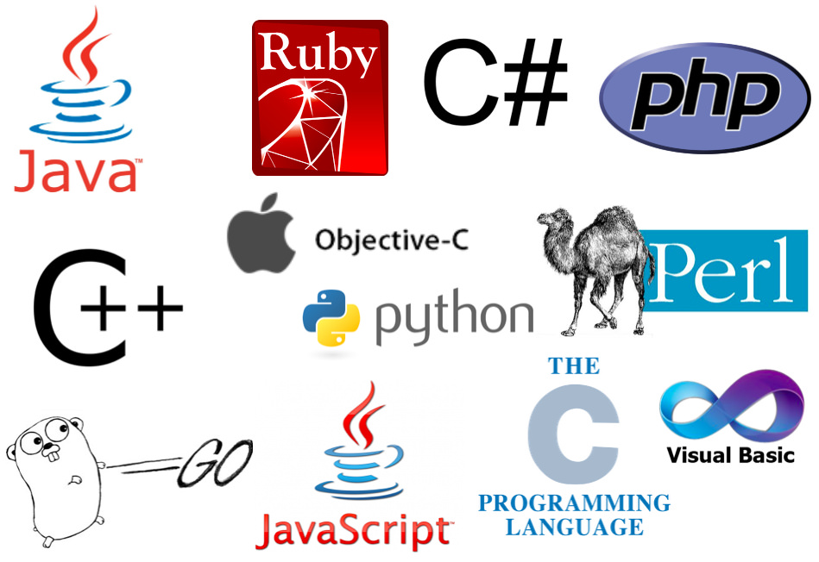
Programming
Throughout this course we will be focusing on PHP, but we will take some time to show how the same concepts are written other languages.
The more programming languages you are exposed to, the more easily you can grasp a new language that you haven’t seen before.
This Photo by Unknown Author is licensed under CC BY-NC

Slide 5
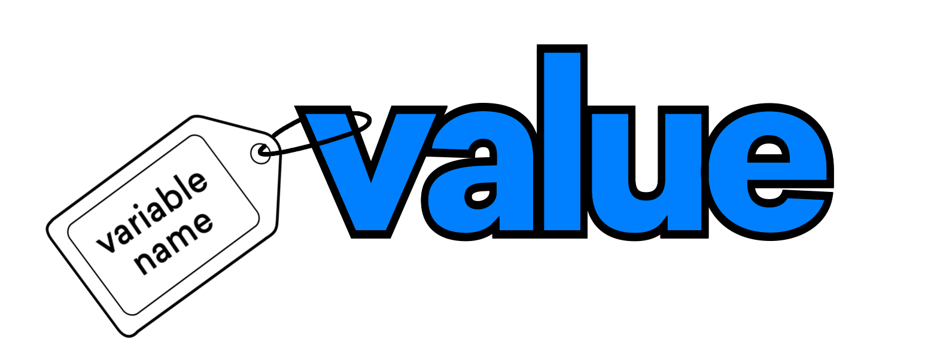
Data Types and Assignments
This Photo by Unknown Author is licensed under CC BY-SA-NC

Slide 6
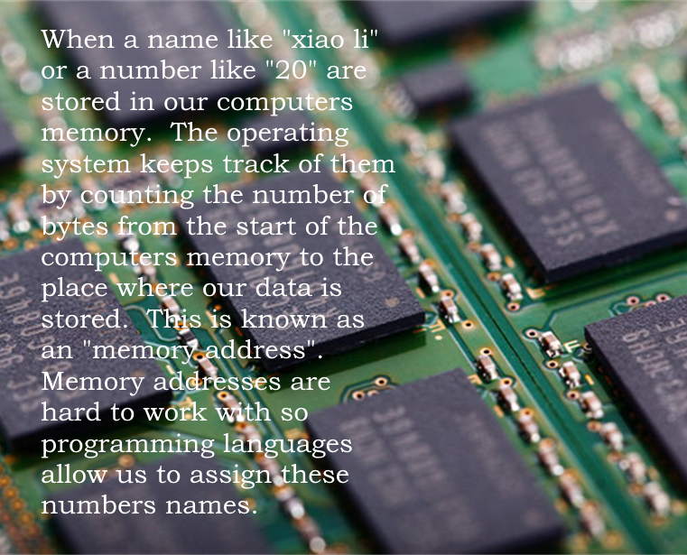
Variables and Data Types
Probably one of the simplest concepts in programming is that computers can store data in their memory. When programming a computer, we can use its memory to store whatever we want.
Just being able to store things in memory is not enough. We also need to be able to fetch things from memory and manipulate them. For this reason, we name these pieces of memory.
A named piece of memory that can be used by a programming language to store something is called a variable!

Slide 7
Data Types
There is a wide variety of data that can be stored in your computer's memory. To start we will discuss just a of these “kinds of data” or Data Types:
Integer: A positive or negative number without decimals. On 32-bit versions of PHP they are from -2,147,483,649 to 2,147,483,648 on 64-bit systems they are from -9,223,372,036,854,775,808 to 9,223,372,036,854,775,807!
Float: These are numbers with decimals. The limits on floating point numbers are complicated. Normally you will never be able to make one so large that PHP can’t deal with it. The term “float” refers to the fact that this data type can have as many or as few decimal places as we want. So, you could say that the decimal point “floats around”.

Slide 8
Data Types
String: Strings are just long lists of characters. Whether you want to store a name or a novel -- you use a string. Older versions of PHP had significant limits on string size. As of PHP 7, they are unlimited for 64-bit versions and 2GB for 32 bit versions! In order to say where a string begins or ends, we use quotes (")
Boolean: A Boolean can only hold one of two values: true or false. These become very important when the computer is making a decision. PHP 7 accepts any arrangement of capital and lower-case letters for these. E.g.,“TRUE”, “TrUe”
Array An array is simply a list of variables. If you want to keep a list of product names you create an array of Strings. If you want to have a list of prices you create an array of floats. You can even mix-and-match different variable types in an array. In order to select which name or price we want we use something called an “index”. In PHP this is, by default a number starting at zero.

Slide 9
Assignments
The statement that we use to relate a piece of memory to a variable name is called an assignment.
In PHP all variable names start with a dollar sign ($) and all statements end with a semi-colon (;)
We tell the computer we want to assign something a name by putting an equals sign next to the name, then following it with the data we want to assign.
PHP Code Examples:
$name = "My name is Jonathan“;
$money_in_my_pocket = 20.00;
$jons_name = $name;
$NAME = "DAVE";
$prod = array("Table","Chair");
$prices = array(12.99,10.50);

Slide 10
Assignment
As you can see, we can assign data to long names. Variable names have a few rules:
Names must start with a $ and then either a letter or an underscore (_).
Names can only contain letters, numbers and underscores.
Assigning a name to another name copies the variable from one name to the other.
Names are “case sensitive”, meaning that $NAME and $name represent two different variables.
PHP Code Examples:
$name = "My name is Jonathan“;
$money_in_my_pocket = 20.00;
$jons_name = $name;
$NAME = "DAVE";
$prod = array("Table","Chair");
$prices = array(12.99,10.50);

Slide 11
Array Assignment
As you saw in the previous example, PHP uses a special structure to create an array. You can even use it to create an empty array.
Once an array is created you can assign data to any index in the array by putting the index inside square brackets [ ]
You can also use this to add elements to the array
PHP Code Examples:
$prod = array("Table","Chair"); $prices = array(12.99,10.50); $empty = array();
$prod[0] = "Desk"; $prices[0] = 15.50;
$empty[0] = "Sarah"; $empty[1] = 22; $empty[2] = "Xiao Li"; $empty[3] = False;

Slide 12
In other languages…
python
C
name = "My name is Jonathan" money_in_my_pocket = 20.00 jons_name = name = "Larry" NAME = "DAVE"
strcpy(name,"My name is Jonathan"); money_in_my_pocket = 20.00; jons_name = name; price = old_price = 5;
RUBY
Java
name = "My name is Jonathan" money_in_my_pocket = 20.00 jons_name = name = "Larry" NAME = "DAVE"
name = "My name is Jonathan"; money_in_my_pocket = 20.00; jons_name = name = "larry"; NAME = name;

Slide 13
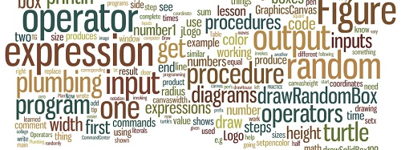
Operators and Expressions

Slide 14
Operators
Computers don’t just store data; they also change and manipulate it. Whenever we want to directly change the data in a variable, we use a symbol to tell the computer what we want it to do. This symbol is called an operator. Whenever we combine a variable with one or more operators. We call this an expression! There are dozens of operators in PHP, we will be focusing on a subset of them.
Operator Name | Symbol | Description | Example | Result (assume $a=2 and $b=3)
Addition | + | Adds together two numbers (either Integer or Float) | $a + $b | 5
Subtraction | - | Subtracts two numbers (either Integer or Float) | $a - $b | -1
Multiplication | * | Multiplies two numbers (either Integer or Float) | $a * $b | 6
Division | / | Divides two numbers (either Integer or Float) | $a / $b | 0.6666666

Slide 15
Assignment Operators
When PHP sees an expression, it performs the function that the operator tells it to. This is called “evaluating an expression”. However, unless we tell the computer to do something with the result. It is immediately forgotten. So, $a + $b; is a valid PHP statement but if we want to do something useful with the result, we need to keep it somewhere. We already know how to do that by using the assignment operator “=“ to put the result in a variable. $c = $a + $b; Because this is needed so often, we have several “shortcut” operators that also do assignment.
Operator Name | Symbol | Description | Example | Result (assume $a=3 and $b=2)
Addition | += | Adds a number to an existing variable. | $a += $b; | 5
Subtraction | -= | Subtracts a number from an existing variable. | $a -= $b; | 1
Multiplication | *= | Multiplies an existing variable by a number. | $a *= $b; | 6
Division | /= | Divides an existing variable by a number. | $a /= $b; | 1.5

Slide 16
Comparison Operators
When you log into your Mohawk account, you type in a username and password. Ever wonder how the computer determines that you are who you say you are? To do this, somewhere it needs to check to see if the data you entered matches the data it has on file. The way you tell a programming language to do this is to use a comparison operator. It’s worth remembering that the result of using a comparison operator is always a Boolean.
Operator Name | Symbol | Description | Example | Result (assume $a=3 and $b=“3”)
Equal | == | True, if both values are equal. | $a == $b | True
Identical | === | True, if values are equal value and the same type. | $a === $b | False
Not Equal | != <> | True, if both values are not equal. | $a != $b $a <> $b | False
Not Identical | !== | True, if values are not equal or not the same type. | $a !== $b | True

Slide 17
Comparison Operators
Operator Name | Symbol | Description | Example | Result (assume $a=3 and $b=4)
Greater Than | > | True, if the first number is greater than the second. | $a > $b | False
Less Than | < | True, if the first number is less than the second. | $a < $b | True
Greater Than or Equal To | >= | True, if the first number is greater than or equal to the second number. Note: You can’t use: => | $a >= $b | False
Less than or Equal To | <= | True, if the first number is less than or equal to the second number. Note: You can’t use: =< | $a <= $b | True

Slide 18
Logical Operators
There are some operators which function exclusively on Booleans. These are called logical operators.
Operator Name | Symbol | Description | Example | Result (assume $a=True and $b=True)
And | and | True only if both inputs are true. | $a and $b | True
Or | or | True, if either input is true. | $a or $b | True
Exclusive Or | xor | True, if either input but not both are true. | $a xor $b | False
Not | ! | Inverts the output of the input. | !$b | False

Slide 19
Conditional Assignment Operator
This is one of the more confusing operators. It looks like this:
$a ? $b : $c
As you can see it takes in three values, if the first value $a is True then the expression evaluates to the second value $b. If the first value is false, then it evaluates to the third value $c. So, if we have…
$a = True; $b = "Dave"; $c = 20;
Then $a ? $b : $c evaluates to “Dave”. However, if we had stated with $a = False;. It would have evaluated to 20.
As most operators only use one or two inputs this sometimes gets called the ternary operator.

Slide 20
Increment Operators
This is another “shortcut” operator used for adding or subtracting a number by just one. Unlike the addition operator these affect the variable without using an assignment. So ++$a; immediately adds one to $a. You can choose if this affects the expression..
Operator Name | Symbol | Description | Example | Result (assume $a=1)
Pre-increment | ++ | Adds 1 to the variable before evaluating the expression. | $b = ++$a; | $a = 2 $b = 2
Post-increment | ++ | Adds 1 to the variable after evaluating the expression. | $b = $a++; | $a = 2 $b = 1
Pre-decrement | - - | Subtracts 1 from the variable before evaluating the expression. | $b = --$a; | $a = 0 $b = 0
Post-decrement | - - | Subtracts 1 from the variable after evaluating the expression. | $b = $a--; | $a = 0 $b = 1

Slide 21
String Operators
Most of the operators we have delt with so far have to do with numbers (either integer or float). Strings can only be either put together (concatenated) or taken apart (sliced). Slicing lets you operate on individual characters in the string. If $a = "Hello" then $a[0] returns “H” and $a[4] returns “o”. You can also use this function to change a specific character in a string.
Operator Name | Symbol | Description | Example | Result (assume $a=“X”. $b=“YZ”)
Concatenation | . | Combines two strings into one. | $a . $b; | "XYZ"
Concatenation Assignment | .= | Combines the second string into the first. | $b .= $a | $a = "X" $b = "YZX"
Slice | [n] | Returns the character from position “n” in the string (starting at zero). | $b[1]; | "Z"
Slice Assignment | [n] | Changes the character at position “n” in the string (starting at zero).. | $b[0]=$a; | $a = "X" $b = "XZ"

Slide 22
Expressions
Expressions are combinations of variables and operators.
When an expression contains many operators. Which operator PHP decides to evaluate first can be ambiguous.
All programming languages have a strictly defined hierarchy of operators. This is known as operator precedence.
As you can see from the chart on the right multiplication is done before addition. So $a = 2 + 3 * 5 will evaluate to 17
Operator(s) | Description
++ -- | Increment and Decrement.
* / | Multiplication and Division.
+ - . | Addition, Subtraction and Concatenation.
?: | Ternary.
= += -= *= /= .= | All assignment operators.
and | Logical and.
or | Logical or.
xor | Logical xor.

Slide 23
Expressions
Increment and decrement have the highest precedence of all so: $a = 2; $b = ++$a * 4; will result in $b = 12 and $a = 3.
Operator(s) | Description
++ -- | Increment and Decrement.
* / | Multiplication and Division.
+ - . | Addition, Subtraction and Concatenation.
?: | Ternary.
= += -= *= /= .= | All assignment operators.
and | Logical and.
or | Logical or.
xor | Logical xor.

Slide 24
Expressions
If you recall, both increment and decrement operators have a “post” form. This means that operation happens after the expression is evaluated. So… $a = 2; $b = $a++ * 4; results in $a = 3 and $b = 8;
Operator(s) | Description
++ -- | Increment and Decrement.
* / | Multiplication and Division.
+ - . | Addition, Subtraction and Concatenation.
?: | Ternary.
= += -= *= /= .= | All assignment operators.
and | Logical and.
or | Logical or.
xor | Logical xor.

Slide 25
Expressions
However, just like in mathematics we can force PHP to evaluate something first by using round brackets: $a = ( 2 + 3 ) * 4; will result in $a = 20.
Operator(s) | Description
++ -- | Increment and Decrement.
* / | Multiplication and Division.
+ - . | Addition, Subtraction and Concatenation.
?: | Ternary.
= += -= *= /= .= | All assignment operators.
and | Logical and.
or | Logical or.
xor | Logical xor.

Slide 26
Expressions and Data Types
As you may have noticed expressions sometimes evaluate to a data type that are different from the data types used as input.
For example, $a = 3 / 2; has two Integers as inputs but the output is 1.5. Which is a Float.
Similarly, 5 == 6 takes in two Integers but outputs a Boolean. In this case False.
Strings can be treated as numbers in PHP so $a = 4.5 + "50" results in 54.5.
In fact, as long as the beginning of a string is all numbers. The string will be treated as a number. So $a = 7 + "10 dogs"; will evaluate to 17 but $a = "I have 10 dogs" + 7; will result in an error.

Slide 27
Expression Practice
$a = 4; $b = 10; $c = 0; $d = 3;
$d += $c++ + $a * $b;
$d = 43 and $c = 1
$a = "hello"; $b = "there";
$c = $b . "went" . $a;
$c = "therewenthello"
$a = "40"; $b = 8; $c = 10; $d = 2;
$e = $c/$d * $b === $a;
$c = False
$a = "10 things"; $b = 9; $c = 4; $d = "Xiao";
$e = $c > $a ? $b : $d;
$e = "Xiao";

Slide 28
In other languages…
python
C
a = 4 b = 2 c = 3 d = 5 d += 1 a += b * c / d
a = 4; b = 2; c = 3; d = 5; a += b * c / ++d;
RUBY
Java
a = 4 b = 2 c = 3 d = 5 a+= b * c / ++d
a = 4; b = 2; c = 3; d = 5; a += b * c / ++d;

Slide 29
In other languages…
python
C
word = "abcde" word[2] == "c"
strcpy(word, "abcde"); word[2] == 'c';
RUBY
Java
word = "abcde" word[2] == "c"
word = "abcde"; word.charAt(2) == 'c';

